Slide 1
Recommendation Systems
Collaborative Filtering
Hybrid Systems
Professor Wei-Min Shen
University of Southern California
Thanks for source slides and material to:
J. Leskovec, A. Rajaraman, J. Ullman: Mining of Massive Datasets
http://www.mmds.org

Slide 2
Three Approaches to Recommendation Systems
1) Content-based
Use characteristics of an item
Recommend items that have similar content to items user liked in the past
Or items that match predefined attributes of the user
2) Collaborative filtering
Build a model from a user's past behavior (items previously purchased or rated) and similar decisions made by other users (“neighbors”)
Use the model to predict items that the user may like
Collaborative: suggestions made to a user utilize information across the entire user base (‘neighbors”)
User-Neighbors vs. Item-Neighbors
3) Hybrid approaches
Notes:
201603w1.1

Slide 3
Collaborative Filtering: Overview
CF works by collecting user feedback: e.g., ratings for items
Exploit similarities in rating behavior among users in determining recommendations
Two classes of CF algorithms:
Neighborhood-based or Memory-based approaches
User-based CF (User’s neighbors)
Item-based CF (Item’s neighbors)
Model-based approaches
Estimate parameters of statistical models for user ratings
Latent factor and matrix factorization models

Slide 4
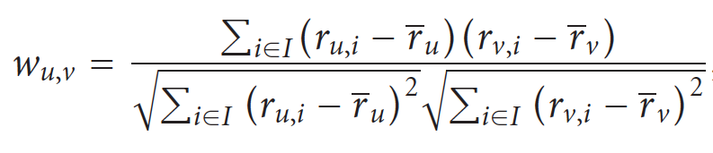
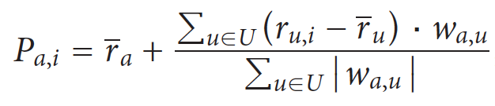
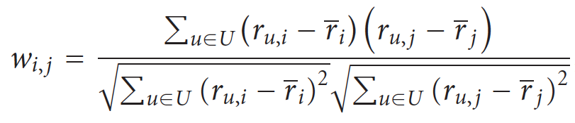
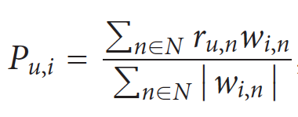
Neighbor-Based Memory-Based Algorithms
Key Ideas of Collaborative Filtering (CF)
Find neighbors by similarity on “averaged rates”
Listen to neighbors with weights (similarity)
Make recommendations
User-based CF: (“User” Neighbors)
Item-Based CF: (“Item” Neighbors)

Slide 5
Making User-based CF Predictions with Pearson: Weighted Sum of Neighbors Ratings
Find neighbors U of an active user a based co-rated items I
Making predictions
Summarize the neighbor U’s weighted ratings for item i

Slide 6
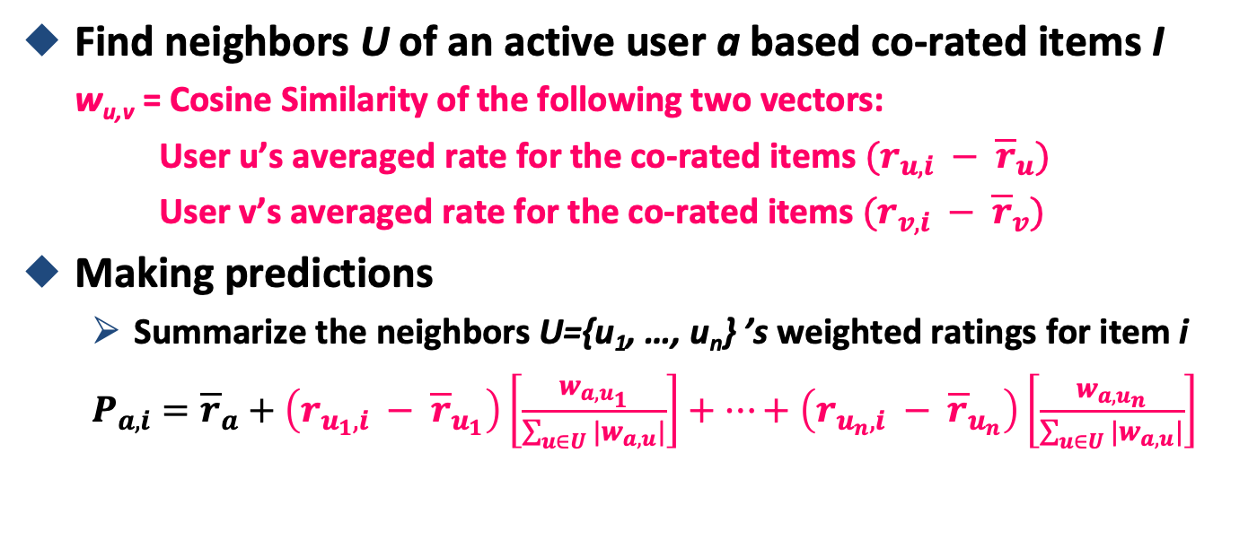
Making User-based CF Predictions with Pearson: Weighted Sum of Neighbors Ratings
You own averaged opinion
Neighbor 1’s opinion
Neighbor n opinion
How much you trust Neighbor n
How much you trust Neighbor-1

Slide 7
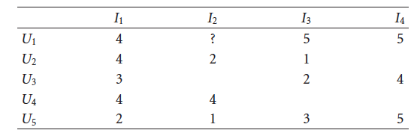
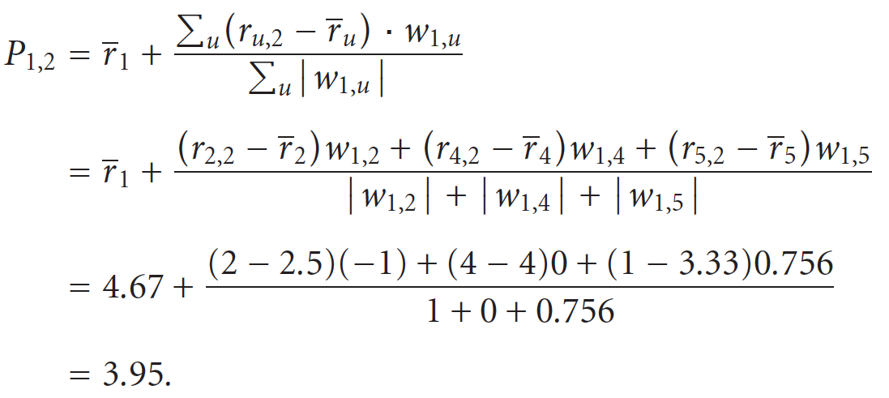
Continued Example: User-Based CF Prediction with Pearson Correlation Coefficient
“average other
than I2”
(4+5+5)/3
(4+1)/2
(4)/1
(2+3+5)/3
Want to predict rating for user U1 on item I2: users U2, U4 and U5 rated I2
Similarity of U1 to these users: w_{1,5} = 0.756, w_{1,4} = 0, w_{1,2} = -1
14/3 = 4.67
5/2=2.5
4/1=4
10/3=3.33

Slide 8
ITEM-BASED CF
Notes:
201603.2 w2.1
201802 w1.1

Slide 9
Item-based Collaborative Filtering
Neighborhood-based CF algorithms do not scale well when applied to millions of users & items
Due to computational complexity of search for similar users (possible solutions?)
Item-to-item collaborative filtering
Rather than matching similar users
Match user’s rated items to similar items
In practice, often leads to faster online systems and better recommendations
Similarities between pairs of items i and j are computed off-line
Predict rating of user a on item i with a simple weighted average
Notes:
2016.3 w2.1

Slide 10
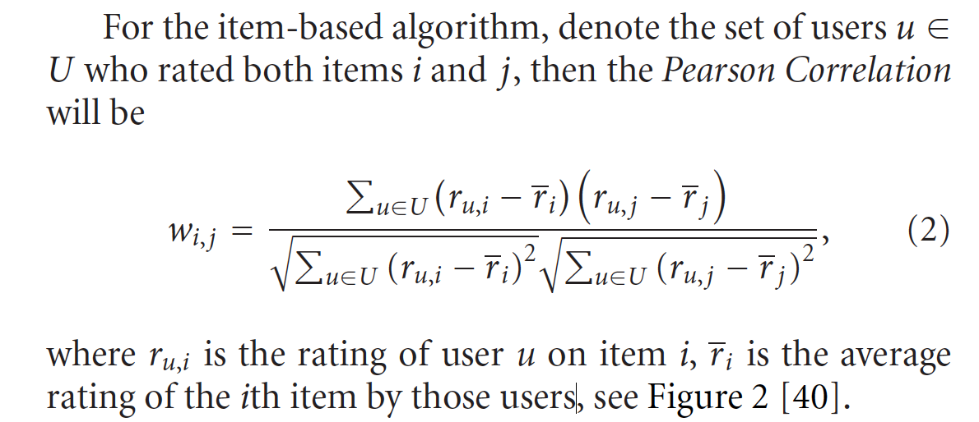
Pearson Correlation between items i, j
_
the cosine similarity of the rate of i, j by u, averaged by the co-users
Note: Sum over set of co-users U who rated both items i, j
r_{u,i} is rating of user u on item i
r_{i} is average rating of i^{th} item by those co-users

Slide 11
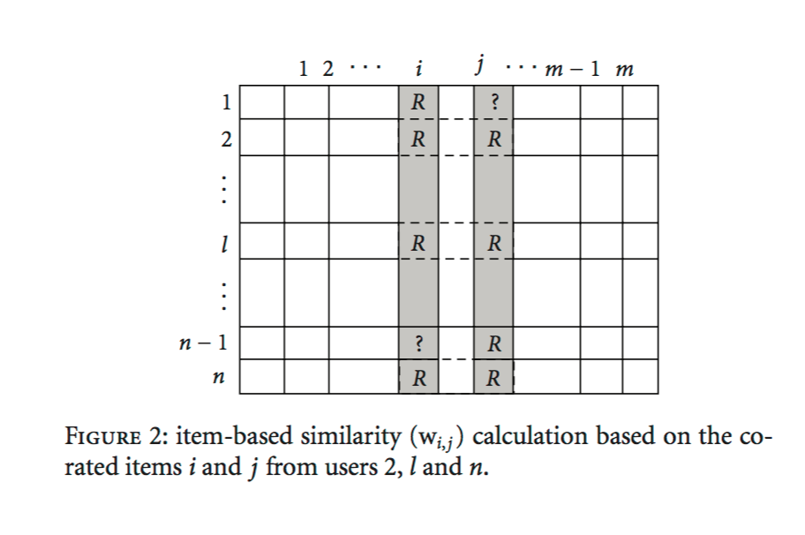
Pearson Correlation between items i, j
Items
Who are the co-users of {i, j}?
Users
Source: Su, X., & Khoshgoftaar, T. M. (2009). A survey of collaborative filtering techniques. Advances in artificial intelligence, 2009, 4.

Slide 12
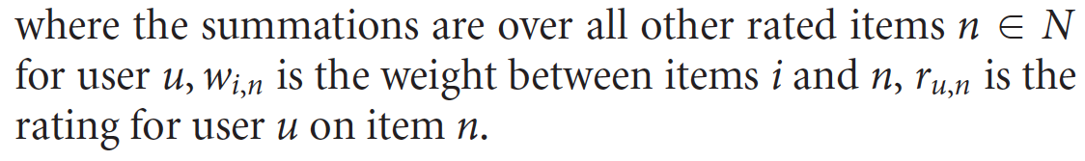
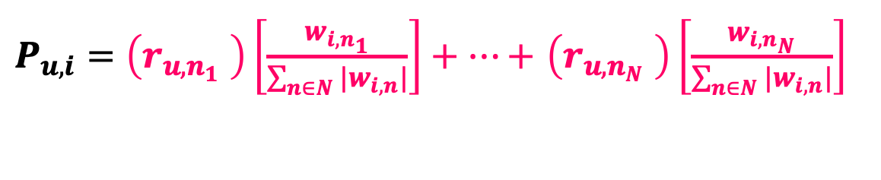
Make Item-Based Predictions Using a Simple Weighted Average
Predict rating for user u on item i
w_{i,n} is weight between items i and n
r_{u,n} is rating for user u on item n
Summation over neighborhood set N of items rated by u that are most similar to i

Slide 13

Make Item-Based Predictions Using a Simple Weighted Average
Predict rating for user u on item i
w_{i,n} is weight between items i and n
r_{u,n} is rating for user u on item n
Summation over neighborhood set N of items rated by u that are most similar to i
Neighbor item n₁’s rate
Neighbor n_{N} opinion
How much you trust Neighbor n_{N}
How much you trust Neighbor n₁
The neighbors of item i are {n₁, …, n_{N}}

Slide 14
Item-Item CF (|N|=2)
users
12 | 11 | 10 | 9 | 8 | 7 | 6 | 5 | 4 | 3 | 2 | 1
 | 4 |  | 5 |  |  | 5 |  |  | 3 |  | 1 | 1
3 | 1 | 2 |  |  | 4 |  |  | 4 | 5 |  |  | 2
 | 5 | 3 | 4 |  | 3 |  | 2 | 1 |  | 4 | 2 | 3
 | 2 |  |  | 4 |  |  | 5 |  | 4 | 2 |  | 4
5 | 2 |  |  |  |  | 2 | 4 | 3 | 4 |  |  | 5
 | 4 |  |  | 2 |  |  | 3 |  | 3 |  | 1 | 6
movies
- unknown rating
- rating between 1 to 5

Slide 15
Item-Item CF (|N|=2)
users
12 | 11 | 10 | 9 | 8 | 7 | 6 | 5 | 4 | 3 | 2 | 1
 | 4 |  | 5 |  |  | 5 | ? |  | 3 |  | 1 | 1
3 | 1 | 2 |  |  | 4 |  |  | 4 | 5 |  |  | 2
 | 5 | 3 | 4 |  | 3 |  | 2 | 1 |  | 4 | 2 | 3
 | 2 |  |  | 4 |  |  | 5 |  | 4 | 2 |  | 4
5 | 2 |  |  |  |  | 2 | 4 | 3 | 4 |  |  | 5
 | 4 |  |  | 2 |  |  | 3 |  | 3 |  | 1 | 6
movies
- estimate rating of movie 1 by user 5

Slide 16
Item-Item CF (|N|=2) First: what is similarity between items?
users
Similarity (made up for example):
w_{1,j}
12 | 11 | 10 | 9 | 8 | 7 | 6 | 5 | 4 | 3 | 2 | 1
 | 4 |  | 5 |  |  | 5 | ? |  | 3 |  | 1 | 1
3 | 1 | 2 |  |  | 4 |  |  | 4 | 5 |  |  | 2
 | 5 | 3 | 4 |  | 3 |  | 2 | 1 |  | 4 | 2 | 3
 | 2 |  |  | 4 |  |  | 5 |  | 4 | 2 |  | 4
5 | 2 |  |  |  |  | 2 | 4 | 3 | 4 |  |  | 5
 | 4 |  |  | 2 |  |  | 3 |  | 3 |  | 1 | 6
1.00
-0.18
0.41
-0.10
-0.31
0.59
movies
Neighbor selection: Identify movies most similar to movie 1 and rated by user 5
Neighborhood size is 2: pick movies 3 and 6

Slide 17
Item-Item CF (|N|=2)
users
Similarity (made up):
w_{1,j}
12 | 11 | 10 | 9 | 8 | 7 | 6 | 5 | 4 | 3 | 2 | 1
 | 4 |  | 5 |  |  | 5 | ? |  | 3 |  | 1 | 1
3 | 1 | 2 |  |  | 4 |  |  | 4 | 5 |  |  | 2
 | 5 | 3 | 4 |  | 3 |  | 2 | 1 |  | 4 | 2 | 3
 | 2 |  |  | 4 |  |  | 5 |  | 4 | 2 |  | 4
5 | 2 |  |  |  |  | 2 | 4 | 3 | 4 |  |  | 5
 | 4 |  |  | 2 |  |  | 3 |  | 3 |  | 1 | 6
1.00
-0.18
0.41
-0.10
-0.31
0.59
movies
Similarity weights: w_{1,3}=0.41, w_{1,6}=0.59

Slide 18
Item-Item CF (|N|=2)
users
Similarity:
w_{1,j}
12 | 11 | 10 | 9 | 8 | 7 | 6 | 5 | 4 | 3 | 2 | 1
 | 4 |  | 5 |  |  | 5 | 2.6 |  | 3 |  | 1 | 1
3 | 1 | 2 |  |  | 4 |  |  | 4 | 5 |  |  | 2
 | 5 | 3 | 4 |  | 3 |  | 2 | 1 |  | 4 | 2 | 3
 | 2 |  |  | 4 |  |  | 5 |  | 4 | 2 |  | 4
5 | 2 |  |  |  |  | 2 | 4 | 3 | 4 |  |  | 5
 | 4 |  |  | 2 |  |  | 3 |  | 3 |  | 1 | 6
1.00
-0.18
0.41
-0.10
-0.31
0.59
movies
Predict by taking weighted average:
P_{5,1} = (0.41*2 + 0.59*3) / (0.41+0.59) = 2.6

Slide 19
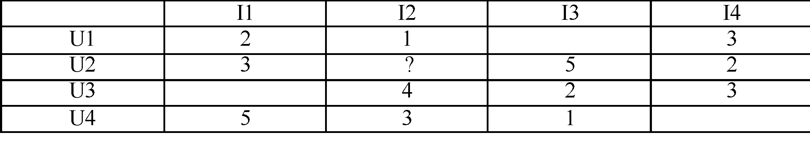
Example: Item-to-Item Collaborative Filtering with Pearson Similarity
What does set U represent?
Set of users U who rated both items i, j
What are the members of the set U for w_{1,2}?
U1 and U4 rated items I1 and I2
When calculating average ratings for item i, which ratings do we use? All ratings or just for co-rated items?
We will show examples of co-rated items
We can use all ratings as well: based on all ratings: avg(r₁) = (2+3+5)/3, avg(r₂) = (1+4+3)/3
Notes:
2017 spring 0201
2018 Spring 0201

Slide 20
Example: Item-to-Item Collaborative Filtering with Pearson Similarity
Based on all ratings: average ratings for items I1, I2: r₁ = 10/3, r₂ = 8/3
Pearson correlation for w_{1,2:} Similarity between items 1 and 2
Set U includes U1 and U4
w_{1,2} = ((r_{U1,I1} – 10/3)(r_{U1,I2} – 8/3) + (r_{U4,I1} – 10/3)(r_{U4,I2} – 8/3)) /
(sqrt((r_{U1,I1} – 10/3)＾2 + (r_{U4,I1} – 10/3)^2) * sqrt((r_{U1,I2} – 8/3)^2) + (r_{U4,I2} – 8/3)^2))
w_{1,2} = [(2-10/3)(1-8/3) + (5-10/3)(3-8/3)] /
[sqrt((2-10/3)^2 + (5-10/3)^2) * sqrt((1-8/3)^2 + (3-8/3)^2)]
= 2.778/3.628 = 0.765

Slide 21
Example: Item-to-Item Collaborative Filtering with Pearson Similarity
co-rated items only
Based on co-ratings: average ratings for items I1, I2: r₁ = 7/2, r₂ = 4/2
Pearson correlation for w_{1,2:} Similarity between items 1 and 2
Set U includes U1 and U4
w_{1,2} = ((r_{U1,I1} – 7/2)(r_{U1,I2} – 4/2) + (r_{U4,I1} – 7/2)(r_{U4,I2} – 4/2)) /
(sqrt((r_{U1,I1} – 7/2)＾2 + (r_{U4,I1} – 7/2)^2) * sqrt((r_{U1,I2} – 4/2)^2) + (r_{U4,I2} – 4/2)^2))
w_{1,2} = [(2-7/2)(1-4/2) + (5-7/2)(3-4/2)] /
[sqrt((2-7/2)^2 + (5-7/2)^2) * sqrt((1-4/2)^2 + (3-4/2)^2)]
=3/3=1

Slide 22
Item-Based Prediction
If we have the following item similarities: w_{2,1} = 0.5, w_{2,3} = 0.2, w_{2,4} = 0.3
Which items are in the neighborhood N for item 2 if |N| = 2?
Items I1 and I4
Predict the rating of user U2 on I2: user = 2, item = 2, |N| = items 1,4
P_{2,2} = [(r_{2,1} * w_{2,1}) + (r_{2,4} * w_{2,4})] / [0.5 + 0.3]
= [3*0.5 + 2*0.3] / 0.8 = 2.625

Slide 23
Extensions to Memory-Based Algorithms
Default Voting (fill in the blanks)
Inverse User Frequency (weed out useless items)
Case Amplifications
Imputation-Boosted

Slide 24
Extensions to Memory-Based Algorithms: Default Voting
In many collaborative filters, pairwise similarity is computed only from the ratings in the intersection of the items both users have rated (“co-rated items”)
Not reliable when there are too few votes to generate similarity values (U is small)
Focusing on co-rated items (“intersection set similarity”) also neglects global rating behavior reflected in a user’s entire rating history
Assuming some default voting values for the missing ratings: can improve CF prediction performance

Slide 25
Extensions to Memory-Based Algorithms: Default Voting (cont.)
Approaches to default voting values:
Herlocker et al. accounts for small intersection sets (small number of co-rated items) by reducing the weight of users that have fewer than 50 items in common
Chee et al. use average of the clique (small group of co-rated items) as a default voting to extend a user’s rating history
Breese et al. use a neutral or somewhat negative preference for the unobserved ratings and then computes similarity between users on the resulting ratings data.

Slide 26
Extensions to Memory-Based Algorithms: Inverse User Frequency
Universally liked items are not as useful in capturing similarity as less common items
Inverse frequency
f_{j} = log (n/n_{j})
n_{j} is number of users who have rated item j
n is total number of users
If everyone has rated item j, then f_{j} is zero
(Note: looks a lot like Inverse Document Frequency (IDF))
Approach: transform the ratings
For vector similarity-based CF: new rating = original rating multiplied by f_{j}
For very popular items, ratings r_{u,i} will be greatly reduced
Less popular items will have greater effect on prediction

Slide 27

Extensions to Memory-Based Algorithms: Case Amplification
Transform applied to weights used in CF prediction
Emphasizes high weights and punishes low weights
Transforms original weights
Reduces noise in the data
Favors high weights
Small values raised to a power become negligible
Example:
For w_{i, j} = 0. 9, weight it remains high (0. 9^{2.5} ≈ 0. 8)
For w_{i, j} = 0. 1, weight becomes negligible (0. 1^{2.5} ≈ 0. 003)

Slide 28
Extensions to Memory-Based Algorithms: Imputation-Boosted CF
When the rating data for CF tasks are extremely sparse: hard to produce accurate predictions using the Pearson correlation-based CF
Su et al. uses imputation-boosted collaborative filtering (IBCF)
First uses an imputation technique to fill in missing data
Then use traditional Pearson correlation-based CF algorithm on this completed data to predict a user rating for a specified item
Example imputation techniques: mean imputation, linear regression imputation, predictive mean matching imputation, Bayesian multiple imputation, and machine learning classifiers (including naıve Bayes, SVM, neural network, decision tree, lazy Bayesian rules)

Slide 29
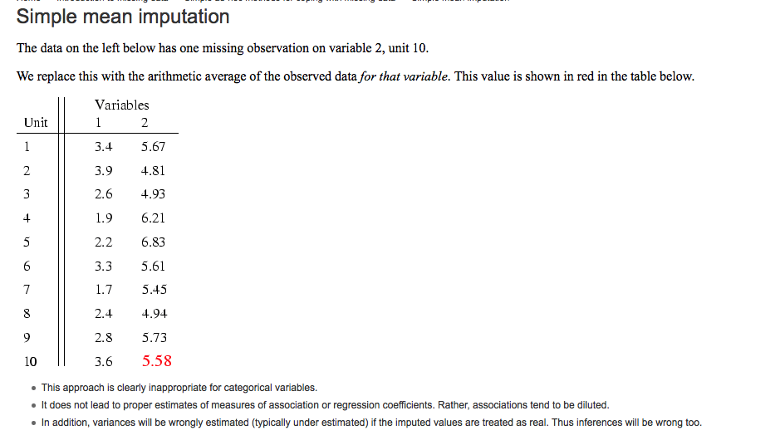
Extensions to Memory-Based Algorithms: Imputation-Boosted CF (Cont’d)
Imputation Example
Source: http://missingdata.lshtm.ac.uk/index.php?option=com_content&view=article&id=68:simple-mean-imputation&catid=39:simple-ad-hoc-methods-for-coping-with-missing-data&Itemid=96

Slide 30
MODEL-BASED CF

Slide 31
Collaborative Filtering Overview
CF works by collecting user feedback: ratings for items
Exploit similarities in rating behavior among users in determining recommendations
Two classes of CF algorithms:
Neighborhood-based or Memory-based approaches
User-based CF
Item-based CF
Model-based approaches
Estimate parameters for statistical models for user ratings
Latent factor and matrix factorization models

Slide 32
Model-based Collaborative Filtering
Provide recommendations by estimating parameters of statistical models for user ratings
Design and development of models can allow system to learn to recognize complex patterns
Based on training set – supervised learning
Then make intelligent predictions for CF tasks based on the learned models
Example models:
Bayesian models
Clustering models
Dependency networks
Classification algorithms (if users ratings are in categories)
Regression models and SVD (singular value decomposition ) methods for numerical ratings

Slide 33
CLUSTERING CF

Slide 34

Clustering CF Algorithms
Cluster = collection of data objects that are:
Similar to one another within the same cluster
Dissimilar to objects in other clusters
Measurements of similarity between objects include
Pearson correlation
Cosine similarity
(it’s important to study your data! E.g., http://grouplens.org/blog/similarity-functions-for-user-user-collaborative-filtering/)
Minkowski distance
Two objects X = (x₁, x₂, …, x_{n}), Y = (y₁, y₂, …, y_{n})
Where q is a positive integer
If q=2: Euclidean distance

Slide 35
Clustering Algorithms
Common clustering method
K-Means
Hierarchical Clustering

Slide 36
Clustering Algorithms (Cont’d)
Key operation: Repeatedly combine two nearest clusters
(1) How to represent a cluster of many points?
Key problem: As you merge clusters, how do you represent the “location” of each cluster, to tell which pair of clusters is closest?
Euclidean case: each cluster has a centroid = average of its (data)points
(2) How to determine “nearness” of clusters?
Measure cluster distances by distances of centroids

Slide 37
K–Means Algorithm(s)
Assumes Euclidean space/distance
Start by picking k, the number of clusters
Initialize clusters by picking one point per cluster
Example: Pick one point at random, then k-1 other points, each as far away as possible from the previous points

Slide 38
Populating Clusters
1) For each point, place it in the cluster whose current centroid it is nearest
2) After all points are assigned, update the locations of centroids of the k clusters
3) Reassign all points to their closest centroid
Sometimes moves points between clusters
Repeat 2 and 3 until convergence
Convergence: Points don’t move between clusters and centroids stabilize

Slide 39
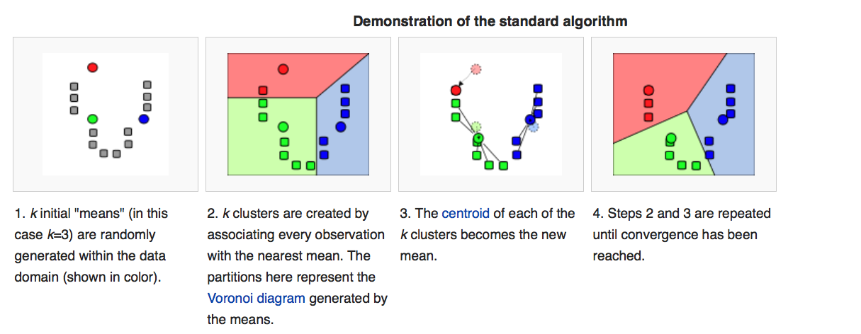
Example: Standard K-Means
Source: https://en.wikipedia.org/wiki/K-means_clustering

Slide 40
Example: Hierarchical clustering
(5,3)
o (4,1)
o (5,0)
(1,2) o
o (2,1)
o (0,0)
x (1.5,1.5)
x (4.7,1.3)
x (1,1)
x (4.5,0.5)
Data:
o … data point
x … centroid
Dendrogram

Slide 41
Clustering CF Algorithms
Clustering is an intermediate step
Resulting clusters used for further analysis or processing
For classification and other tasks
Example: partition data into clusters; then use memory-based CF algorithm like Pearson correlation to make predictions within each cluster
Clustering algorithms have better scalability than typical CF methods because they make predictions on smaller clusters rather than whole customer base
Complex and expensive clustering computation run offline
Recommendation quality is generally low
Optimal clustering over large data sets is impractical
Most applications use greedy cluster generation techniques

Slide 42
REGRESSION-BASED CF

Slide 43
Regression-based CF Algorithms
Numerical ratings are common in real recommender systems
Regression methods: good at making predictions for numerical values
Uses an approximation of the ratings to make predictions based on a regression model

Slide 44
Linear Regression
Data are modeled using linear predictor functions, and unknown model parameters are estimated from the data
Such models are called linear models
If the goal is prediction, forecasting, or reduction, linear regression can be used to fit a predictive model to an observed data set of y and X values
After developing such a model, if an additional value of X is then given without its accompanying value of y
the fitted model can be used to make a prediction of the value of y

Slide 45
Regression method
Let X = (X1, X2, …, XN) be a random variable representing user’s preference on different items
Linear regression method:
Y = MX + N
Where M is an n x k matrix
N = (N₁, …., N_{n}) is a random variable representing noise in user choices
Y is an n x m matrix where Y_{ij} is rating of user i on item j (typically very sparse)
X is a k x m matrix with each column as estimate of the value of the random variable X (user’s rating in k-dimensional rating space for one user)

Slide 46
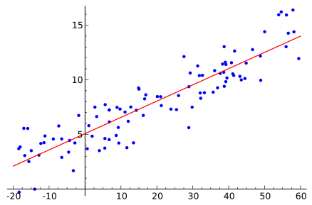
Example: Linear Regression
Source: https://en.wikipedia.org/wiki/Linear_regression

Slide 47
LATENT FACTOR MODELS

Slide 48


Matrix Decomposition Techniques in Machine Learning and Information Retrieval
Thomas Hofmann
Associate Professor
Department of Computer Science
Brown University
th@cs.brown.edu
www.cs.brown.edu/~th

Slide 49

Latent Factor Models

Slide 50

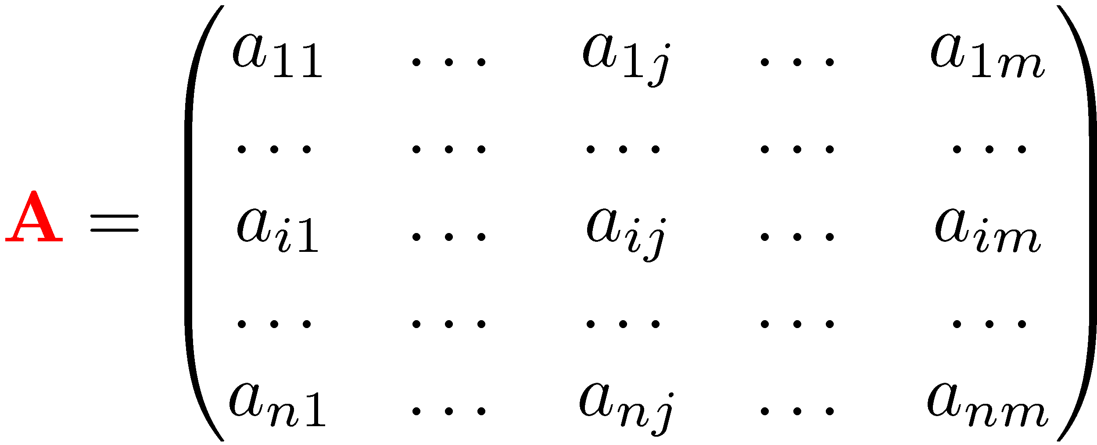
Latent Structure
Given a matrix that “encodes” data ...
Potential problems
too large
too complicated
missing entries
noisy entries
lack of structure
...
Is there a simpler way to explain entries?
There might be a latent structure underlying the data.
How can we “find” or “reveal” this structure?

Slide 51
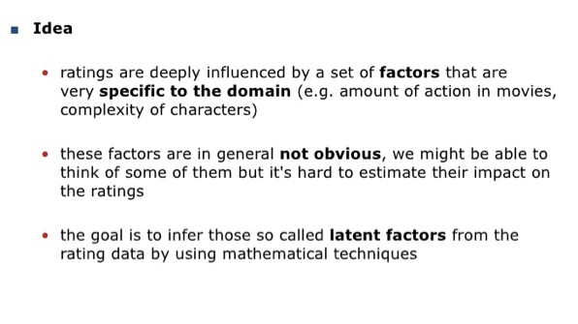
Latent Factor Models

Slide 52







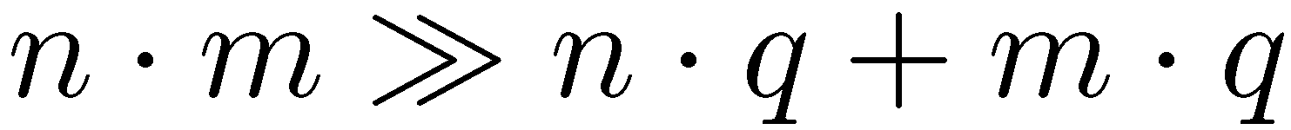
Matrix Decomposition
Common approach: approximately factorize matrix
Factors are typically constrained to be “thin”
approximation
left factor
right factor
⋅
≈
reduction
factors = latent structure

Slide 53
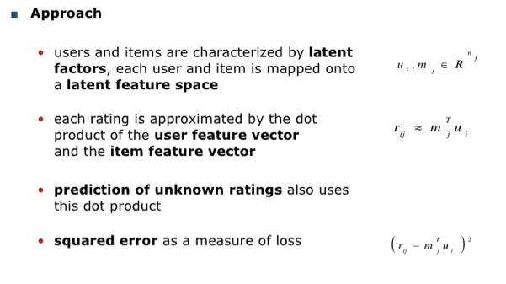
Latent Factor Models

Slide 54
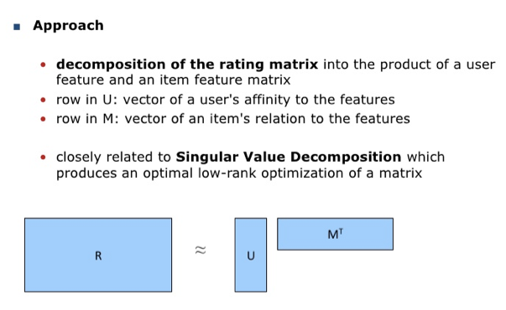
Latent Factor Models

Slide 55
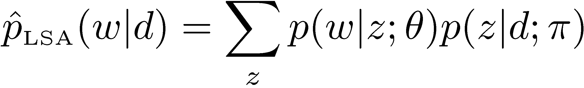
pLSA – Latent Variable Model
Structural modeling assumption (mixture model)
[Hofmann, Proceedings ACM SIGIR, 1999]
Document
language model
Document-specific
mixture proportions
Latent concepts
or topics
Concept expression
probabilities
Model fitting

Slide 56
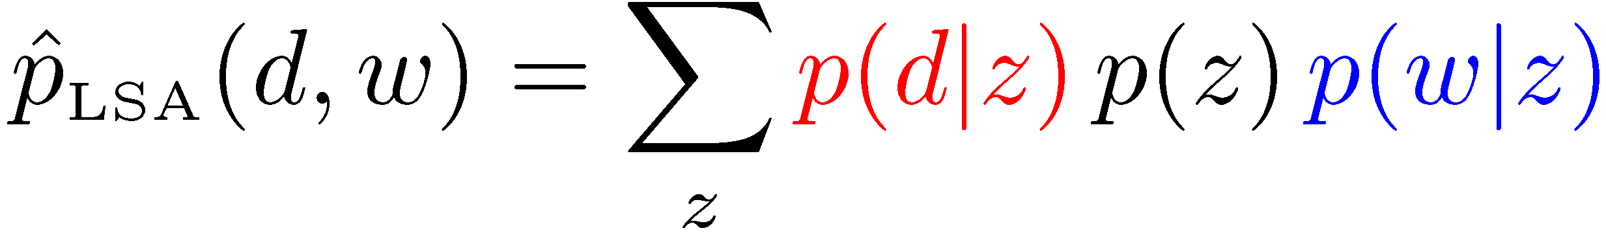

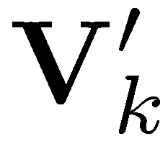


pLSA: Matrix Decomposition
Mixture model can be written as a matrix factorization
Equivalent symmetric (joint) model
Contrast to LSA/SVD: non-negativity and normalization (intimate relation to non-negative matrix factorization)
...
=
concept
probabilities
pLSA term
probabilities
...
pLSA document
probabilities

Slide 57
Rating Matrix
Rating matrix is typically a large matrix with many (mostly) missing values
item
3
...
5
...
2
4
...
1
user
...
...
...
...
...
...
missing ratings
1
...
1
1
...
3

Slide 58
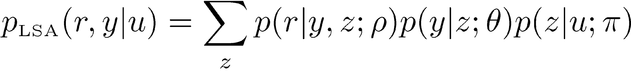
pLSA-like Decomposition
Generalization of pLSA (additional rating variable)
Explicit decomposition of user preferences (each user can have multiple interests)
Probabilistic model can be used to optimize specific objectives
Data compression and privacy preservation
Details
multinomial or Gaussian sampling model for rating variable
EM algorithm for (approximate) model fitting
extension to
predict ratings
standard pLSA model to
explain sparseness pattern
T. Hofmann, Latent Semantic Models for Collaborative Filtering, ACM Transactions on Information Systems, 2004, Vol 22(1), pp. 89-115.

Slide 59
CHARACTERISTICS AND CHALLENGES OF COLLABORATIVE FILTERING

Slide 60
Challenges of CF
Data Sparsity
Cold Start Problem
Synonyms
Scalability
Gray Sheep and Black Sheep
Shilling attacks

Slide 61
Characteristics and Challenges of Collaborative Filtering
Data Sparsity
Many commercial recommender systems are used with very large product sets
Most users do not rate most items: User-item matrix is extremely sparse
For CF: reduces probability of finding set of users with similar ratings
Approaches:
Dimensionality reduction techniques
Singular Value Decomposition (SVD): remove unrepresentative or insignificant users or items to reduce size of user-item matrix
Latent semantic Indexing: similarity between users is determined by representation of users in reduced space
Principle Component Analysis

Slide 62
Characteristics and Challenges of Collaborative Filtering
Data Sparsity (cont.)
Dimensionality reduction techniques
When users or items are discarded:
Useful information for recommendations may be lost
Recommendation quality may be degraded

Slide 63
Challenges (cont.)
Cold start problem
When a new user or item has just entered the system
Hard to find similarities: not enough information to make good recommendations
New item problem: can’t be recommended until some users rate it
Also applies to obscure items
Also called “first-rater problem”
New users: not given good recommendations because of lack of rating or purchase history
Approaches:
Content-based systems do not rely on ratings from other users
Hybrid CF (content-boosted CF): external content information can be used to produce predictions for new users or new items
Research on effectively selecting items to be rated by a user to rapidly improve recommendation performance

Slide 64

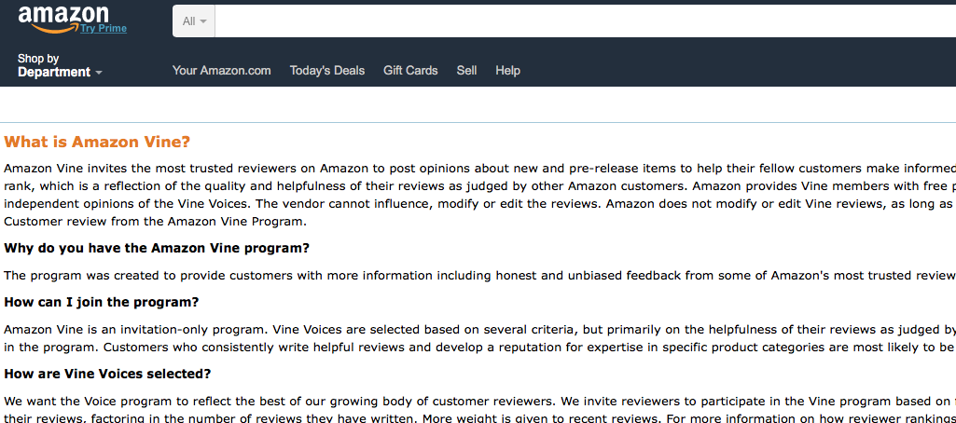
Amazon Vine

Slide 65
Challenges (cont.)
Synonyms
Same or very similar items that have different names or entries
Most recommender systems are unable to discover this latent association
Treat these products differently
Synonyms decrease recommendation performance of CF systems
Approaches
Automatic term expansion or construction of thesaurus
Some added terms may have different meanings than intended
SVD techniques: Latent Semantic Indexing (LSI): construct a semantic space where terms and documents that are closely associated are placed close to each other

Slide 66
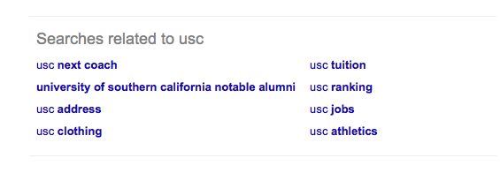
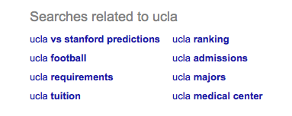
Example: Latent Semantic Indexing (LSI)

Slide 67
Challenges (cont.)
Scalability
Traditional CF systems suffer scalability problems at very large scale
With tens of millions of customers (M), millions of catalog items (N): and O(n) algorithm is too large
Approaches
Dimensionality reduction (SVD) can scale and quickly produce good recommendations
But have to do expensive matrix factorization
Memory-based CF algorithms (e.g., item-based Pearson correlation CF algorithm) have good scalability
Instead of calculating similarities between all pairs of items, calculate similarity only between pairs of co-rated items by a user

Slide 68
Challenges (cont.)
Gray Sheep
Users whose opinions do not consistently agree or disagree with any group of people
Do not benefit from collaborative filtering
Approaches:
Hybrid approach combining content-based and CF recommendations
Base prediction on weighted average of content-based prediction and CF prediction
Black sheep
Idiosyncratic tastes make recommendations nearly impossible: considered an acceptable failure

Slide 69
Challenges (cont.)
Shilling attacks
Shill definition
Noun: an accomplice of a hawker, gambler, or swindler who acts as an enthusiastic customer to entice or encourage others
Verb: act or work as a shill
In systems where anyone can provide ratings (Yelp, Amazon):
People may give many positive ratings for their own materials
Negative recommendations for competitors
CF systems want to discourage this phenomenon
Approaches (research)
Item-based less affected than user-based
Hybrid CF systems provide partial solutions

Slide 70
Pros/Cons of Collaborative Filtering
+ Works for any kind of item
No feature selection needed
- Cold Start:
Need enough users in the system to find a match
- Sparsity:
The user/ratings matrix is sparse
Hard to find users that have rated the same items
- First rater:
Cannot recommend an item that has not been previously rated
New items, Esoteric items
- Popularity bias:
Cannot recommend items to someone with unique taste
Tends to recommend popular items

